Slide 1
Community Grants Fall 2020
Welcome! Please..
introduce yourself via the Chat box
mute your microphone
ask questions via the Chat box
Penny Scott
Grants Coordinator
grants@cfka.org
613.546.9696

Slide 2
Agenda
Welcome
Overview - Community Foundation
Overview – Fall 2020 Community Grants Program
Review of application forms & budget
Q & A
Wrap up

Slide 3
Community Foundation Facts
25th Anniversary!
Over 200 endowment funds from which it makes charitable grants
4 different granting programs each with own set of criteria, application process
Community Grants Program- broadest eligibility criteria
Funded by earnings on pooled donations & over 40 endowment funds from donors

Slide 4
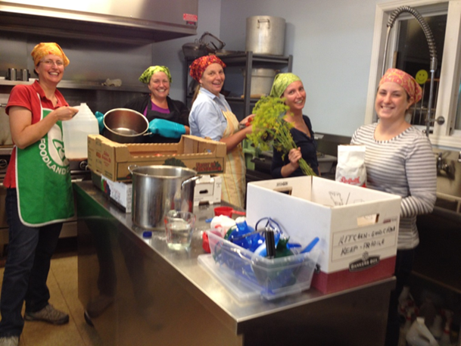
Community Grants
Program
The Community Grants Program seeks projects that:
  Enhance quality of life in our community
  Strengthen infrastructure of community organizations and their ability to offer services
  Demonstrate innovation

Slide 5

Fields of Interest
Health and Social Services
Youth
Arts & Culture
Community Development
Education & Literacy
Heritage Preservation
Recreation
Environment
Children’s Mental Health
Smart & Caring PRIORITIES
You should choose one field of interest (FOI) and, only when applicable, one S&C area. Do not be concerned about choosing the correct FOI or limiting yourself. We are able to match funds accordingly, regardless of what one you have chosen.

Slide 6
Smart & Caring priority areas
This fund invests in priority areas based on evidence emanating from our Vital Signs® reports and discussions with community partners. Current priority areas are:
Getting Started – Giving children, youth and newcomers a strong start to life in our communities.
Food Security – Ensuring everyone has access to healthy food to fuel their bodies and minds; providing education for food choices and preparation.
Community Engagement – Inspiring everyone to be active participants in our communities, enriching our society individual by individual.
Emergency response and recovery – Supporting community resiliency in the event of unanticipated circumstances that affect the health, security and wellbeing of Kingston & Area residents including mitigation & recovery.

Slide 7
Eligibility criteria
Registered charity or partner with a registered charity or municipality
In our granting area*
Strong local presence
Final reports from previously completed projects submitted
*Children’s mental health projects may be located in Lennox & Addington, and environmental projects may also be in the Cataraqui Watershed in addition to our regular granting area

Slide 8
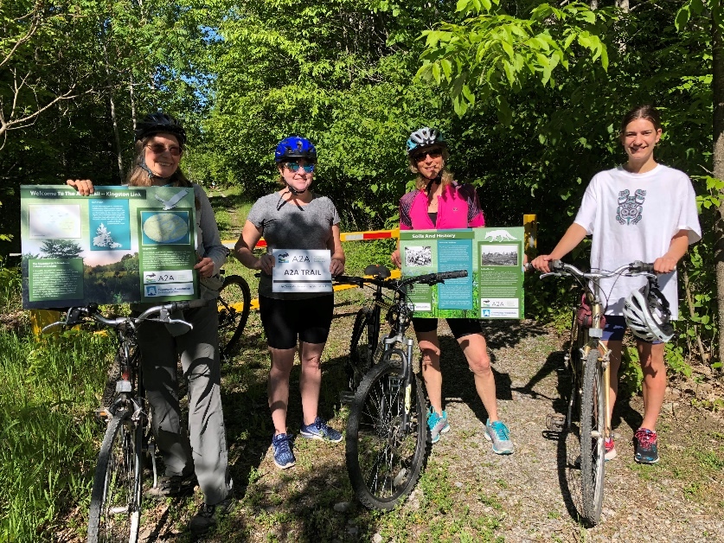
Funding sources
Investment income from more than 40 funds:
  Field of interest (e.g. Arts, Children’s Mental Health)
  Donor-advised
  Donor-designated
  General community funds (unrestricted)

Slide 9
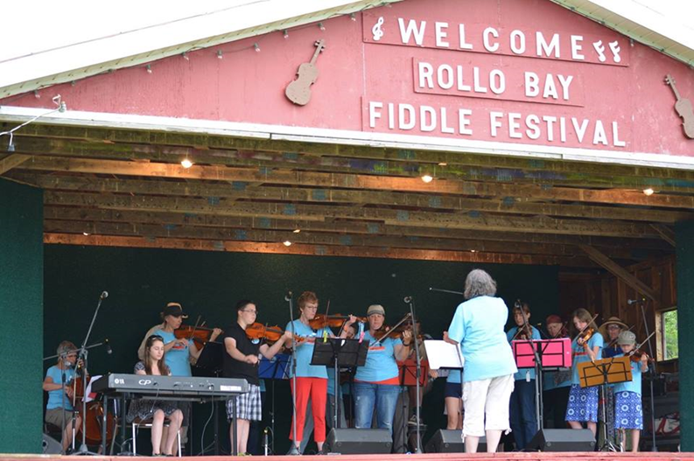
Ineligible expenses
Sectarian, religious or political activities
Retirement of debts
Provision of endowment funds
Annual drives for fundraising

Slide 10
What’s different?
Granting Priorities
Applicant Guide
Shorter and more concise application forms
Faster application processing-grants in November 2020
No paper submissions required
One-time opportunity to apply for emergency operational support for program delivery during COVID – 19

Slide 11
Granting Priorities - Fall 2020
Partnerships: Look to partner, collaborate, and coordinate with others in the application. Opportunities may exist to share resources, equipment, space costs, etc.
Diversity & Inclusion: Consider diversity, equity and inclusion in the project/program design and delivery.
Resilience: Develop initiatives that build on existing strengths and develop resiliency in people, organizations, and community.
Emergency Response & Recovery: Continued efforts to address the effects of COVID-19.

Slide 12

New Forms
FORM N
  For new projects or initiatives
FORM O
  For operational support
FORM E
  For capital/equipment ONLY

Slide 13
FORM N
For new projects or initiatives
Focus on key questions-shorter more concise
Will be the most familiar to applicants
Must include budget
Partnership Agreements accepted (exception school boards)

Slide 14
FORM O
One-time opportunity to apply for emergency operational support for program delivery during COVID – 19
Although applicant may offer multiple programs, must choose one
Shorter form-no partnership agreements
Must clearly identify how has COVID-19 affected their ability to deliver the project, program, or initiative
Must include budget that identifies the annual program cost (shared, pro-rated and actual)
Subject to a maximum of 20% of program cost up to a maximum of $15,000

Slide 15
DOGGOS Kingston is a registered charity that supports responsible dog ownership. Overall annual budget of $70,000. They run 3 programs in the community, all of which have been affected by COVID-19:
Keeping Your Dog Fit
Obedience Training for New Dog Owners
Fostering Dogs
Obedience Training for New Dog Owners
Determine annual cost to run the program, assuming no revenue sources.
Staff
Materials
Dog treats
Rent (pro-rated as a %)
Etc.
Calculated Annual Cost for Program - $12,000
$12,000 x 20% = $2,400
Maximum Operational Grant : $2,400

Slide 16
FORM E
For capital/equipment ONLY
Very short form
Note:
For new projects or initiatives, include the costs in your budget. No need to compete Form E as well.

Slide 17
What makes a strong proposal?
Well-written, clear, concise answers, descriptions and anticipated outcomes (WHAT)
Clear, demonstrated community need/gap (WHY)
Well described plan to carry out project & plan to assess your described outcomes (HOW)
Strong support for project indicated through things other grants sought, partnerships, volunteer efforts and in-kind supports
Not a duplication of existing programs of services
(and of course)
Prepared with passion and enthusiasm!

Slide 18
Some FAQs
Applicants may submit more than one application for a new initiative.
Applicants may submit only one application for an emergency operational grant.
Applicants may apply for both a new initiative grant AND for an emergency operational grant.

Slide 19
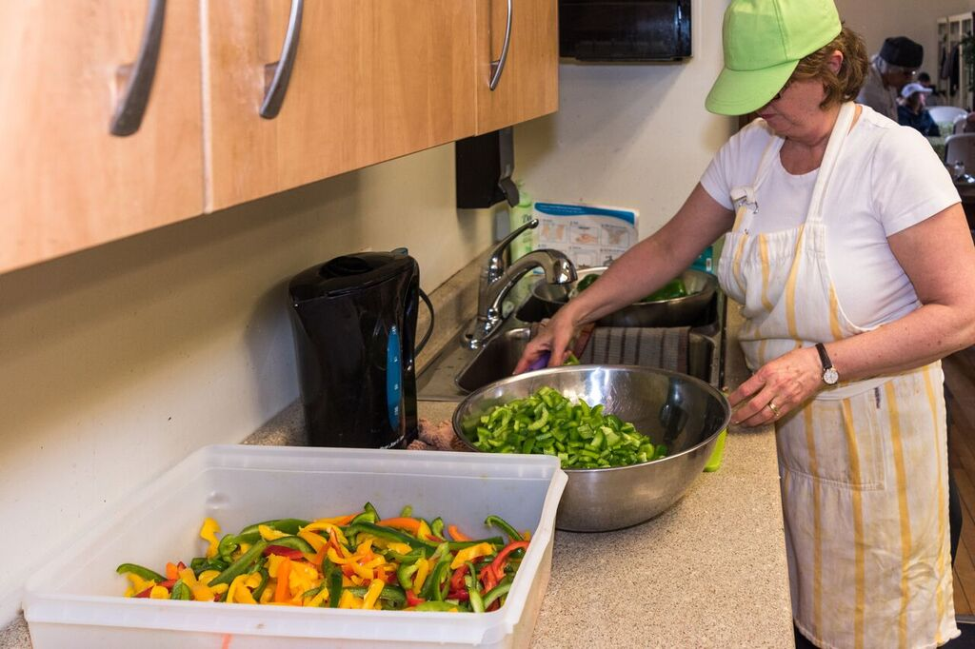
Preparing your application
Read carefully over eligibility and Applicant Guide
Don’t leave anything blank
Use the Checklist
Documents to be submitted in Word & Excel format.
Financial statements & supporting documentation-can be PDF
No paper copies required
Deadline: Sept. 15th by 4:30pm

Slide 20

Funding levels and budgets
Funding levels vary year-to-year
Grants from $500-$25,000 have been given out in the past
Partial funding possible
Submit the most current financial information
audited or unaudited financial statements
bank statements
a balance sheet
an income statement

Slide 21
Community Grants Review Process
Volunteer Community Grants Committee reviews applications and make recommendations for granting.
All applicants notified about the outcome by email in early November 2020 and after signing a grant agreement-cheques will be issued to successful grantees by mid-November.
Final reports are due within 30 days of project completion (up to 13 months after grant awarded)

Slide 22
Discussion
&
Questions

Slide 23
Is the answer/clarification in the Guide?
I can’t help you if you don’t contact me!
Tel: 613.546.9696
Email: grants@cfka.org
I am in the office Tuesday - Friday

