Slide 1
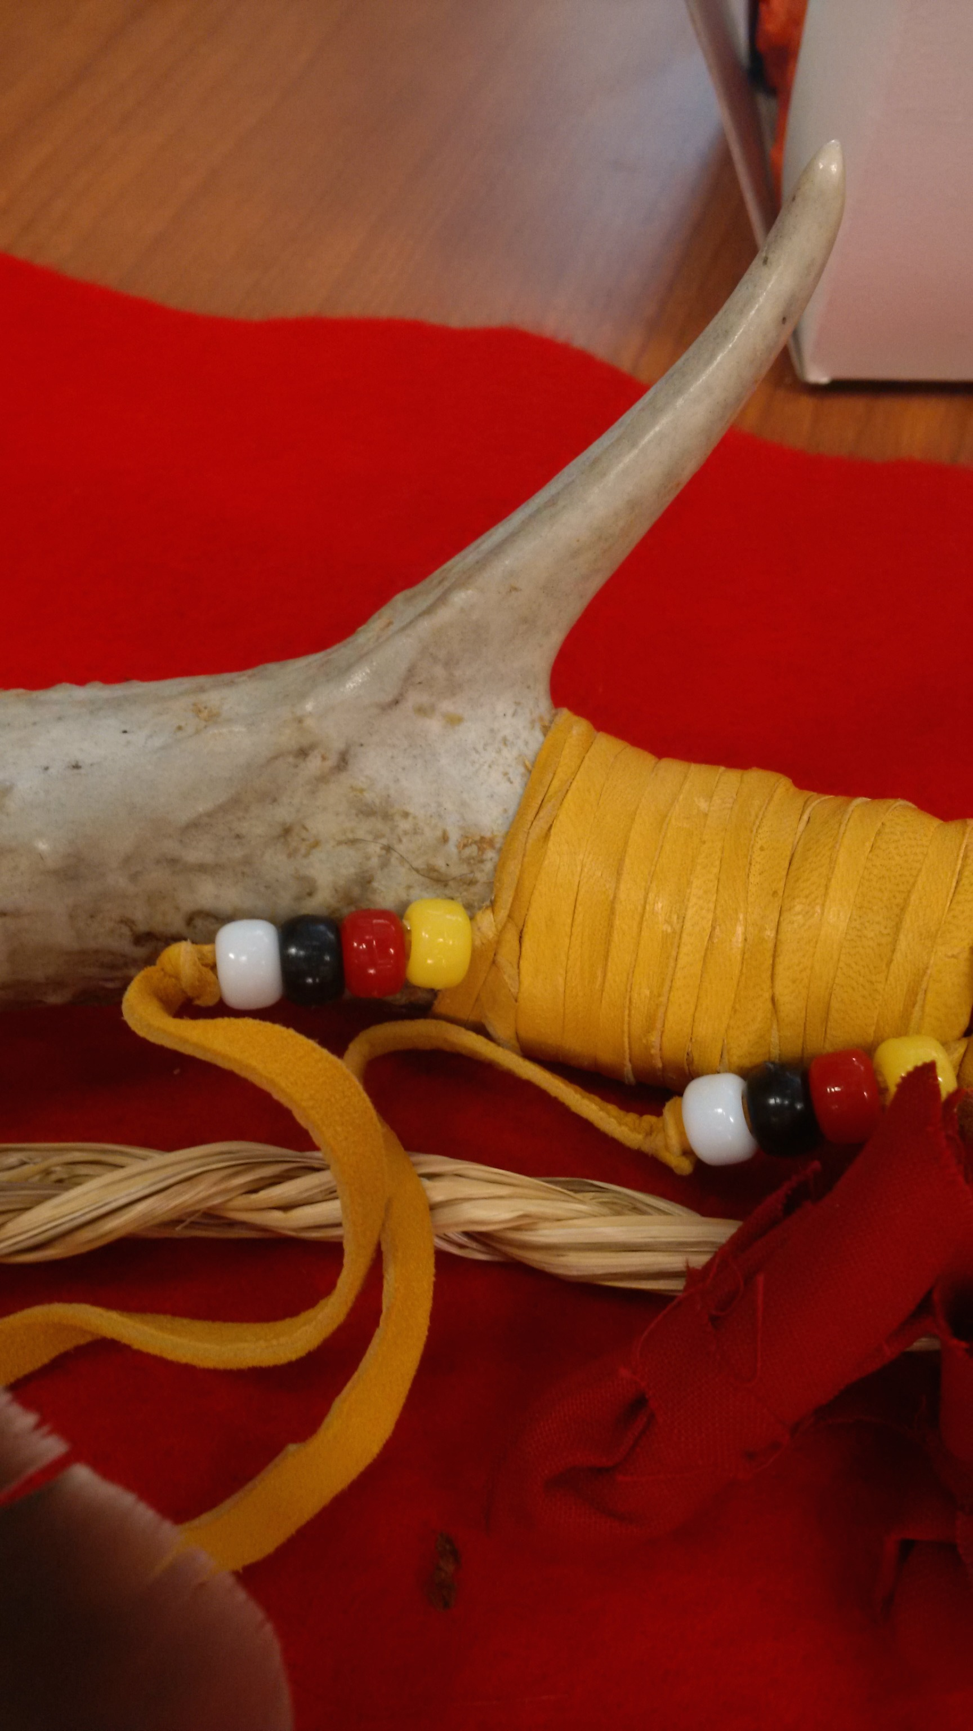
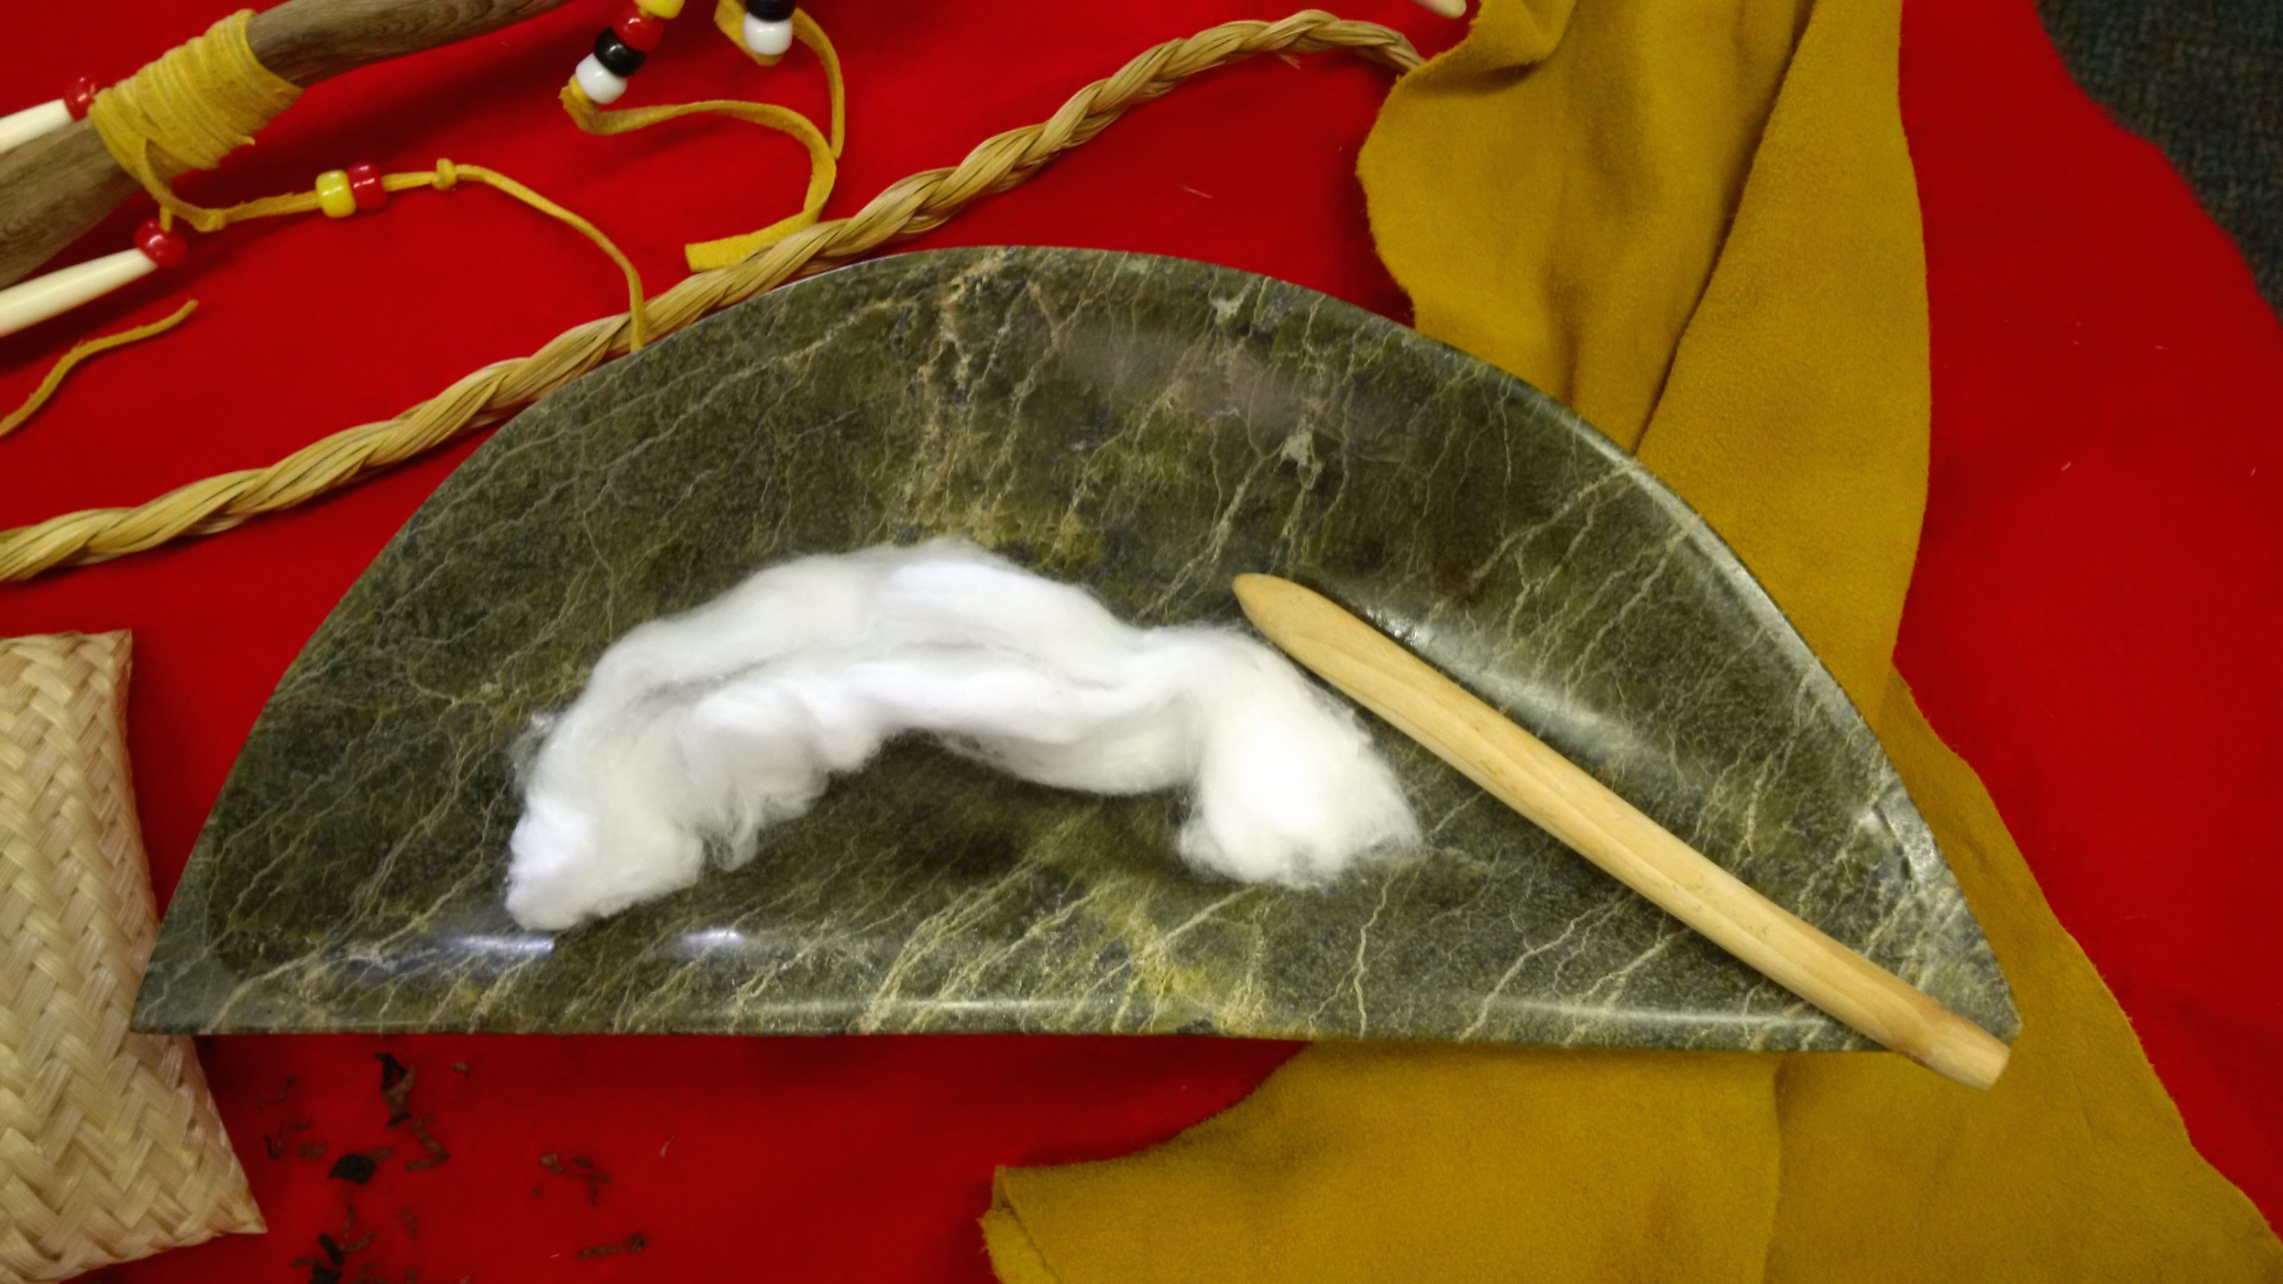
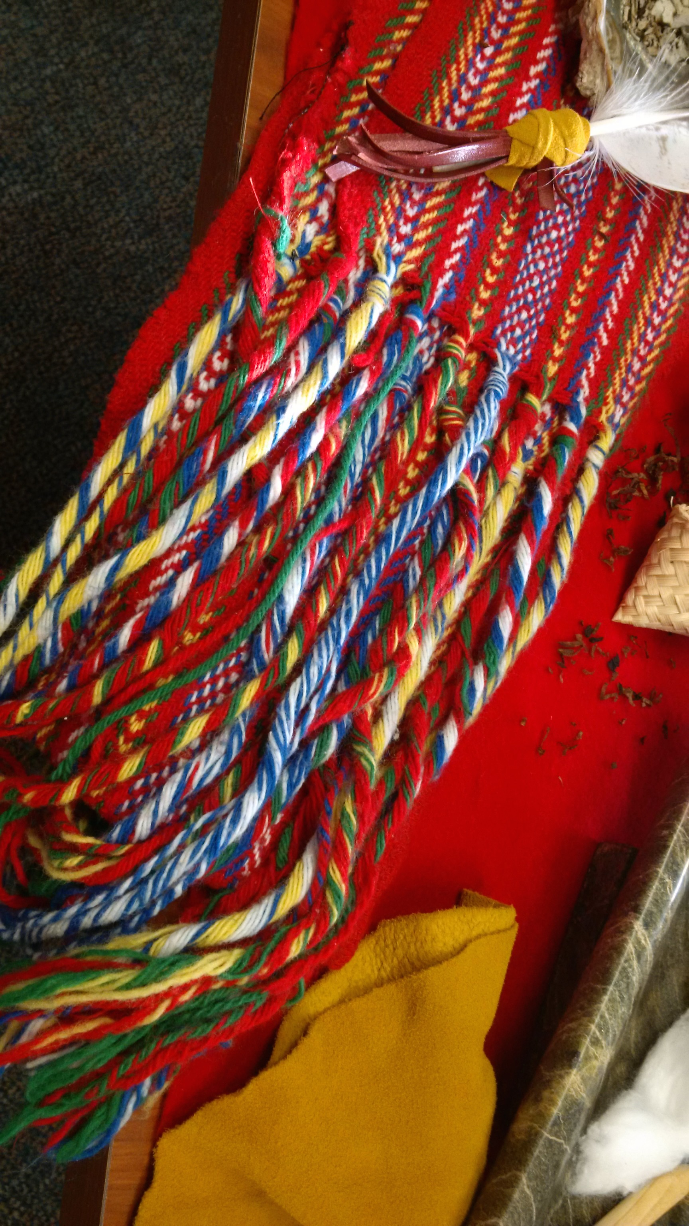
CFKA Speakers Series Truth & Reconciliation in the Kingston Area: What’s Your Role?
Dr. Terri-Lynn Brennan
Cultural Services, City of Kingston
Wednesday April 27, 2016
Notes:
She:kon, Aanii, Boozhoo, Kwey Kwey, Wachaya, Tawnsi, Hello. [read CoK recognition statement as passed by council June 2015]. This statement was scripted entirely by Kingston’s First Peoples community and presented to council for adoption. One element that prompted the creation and adoption of an official city recognition statement was the work and report of the TRC.

Slide 2
What is the TRC?
In response to the 1996 Report of the Royal Commission on Aboriginal Peoples…
In response to the 2008 Statement of Apology by the Prime Minister…
In response to the 2008 Indian Residential Settlement…
Notes:
Over 7 years, and after the collection of nearly 7000 personal witness statements by a range of national leaders from Shelagh Rogers at CBC Radio to newly elected MPP Wab Kinew, who some of you might know better as the moderator for the 2015 Canada Reads series.

Slide 3
The TRC or Truth and Reconciliation Commission was established in 2008 to: (1) reveal to Canadians the complex truth and legacy of residential schooling; (2) guide and explore a process of healing and reconciliation.
Notes:
After a comprehensive examination by the Truth and Reconciliation Commissioners, the legacy and capture of over 150,000 students in Canada’s residential school system can now be described as “cultural genocide” which aimed to assimilate Indigenous children into Canadian society by forcibly removing them from their families in the hopes that they would “cease to exist as distinct legal, social, cultural, religious and racial entities in Canada.”

Slide 4
The Truth & Reconciliation Commission of Canada 94 Calls to Action
www.trc.ca
Notes:
Along with the revealing testimony of prior students and the need to rewrite Canadian history books, the TRC report issued 94 Calls to Action that specifically directed Federal, Provincial, Territorial and Municipal governments, post-secondary institutions, especially within the areas of medicine, nursing and law, church leaders and groups, museum and archives as well as media outlets to respond with positive action.

Slide 5
What is Reconciliation?
Reconciliation as Relationship.
Notes:
As a representative of Cultural Services I have begun talks with diverse Kingston Indigenous community members to begin gathering data on needs and assets, therefore what they offered me in response to the question of all what “role” Kingstonian’s should play toward addressing the TRC Calls to Action….

Slide 6
Your role… listen more than speak.

Slide 7
Understand and Respect “Titles”
…Indian, Native, Aboriginal/Autochtone, First Nations, Metis, Inuit, First Peoples, Original Peoples, Indigenous…
Notes:
This list is hopefully a prompt that individuals will take on the linear aspect of moving away from the first title toward adopting the last three titles in all conversations…

Slide 8
First Peoples of Canada
First Peoples: (noun) the descendants of the original inhabitants of North America and the term is a reference to individual experience and identity. The Canadian Constitution recognizes three groups of “Original” Peoples – First Nations, Métis and Inuit. These are three separate peoples with unique heritages, languages, cultural practices and spiritual beliefs.
http://www.aadnc-aandc.gc.ca/eng 1100100014642/1100100014643

Slide 9
Recognize Diversity
Notes:
The community also calls out for…

Slide 10
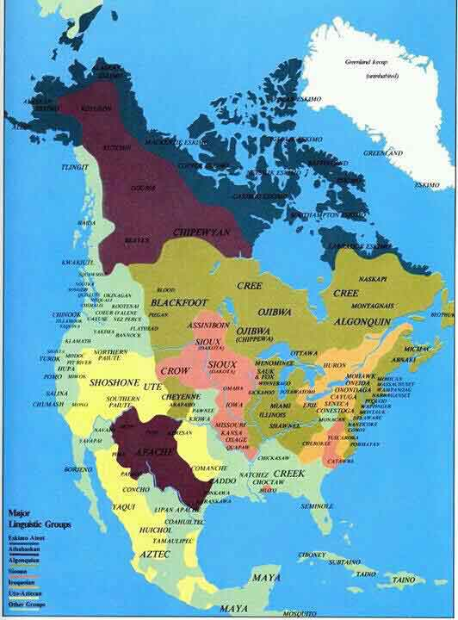
Notes:
Anthropologists and Archaeologists have estimated at the time of the First Europeans landing on Turtle Island, otherwise now known as North America, there was anywhere from 125 million to 250 million First Peoples covering the continent. Half in what is now Canada, the other half across the US. In 2013 the First Peoples population of Canada was estimated at 1.4 million resulting in the loss of approximately 75 to 100 million people over the period of colonization.

Slide 11
Kingston’s Diverse First Peoples Community
Inuit from Iqaluit, Nunavut
Inuit from Tuktoyaktuk, Northwest Territories
Nacho Nyak Dun from the Yukon
Haidi Gwaii and Coast Salish from British Columbia
Black Foot from Alberta
Saulteaux and Métis from Manitoba
Cree, Ojibway, Mohawk, Oneida, Mississauga, and Algonquin from across Ontario and Quebec
Mi’kmaq from Nova Scotia, PEI, Newfoundland
Notes:
Although the overall population has greatly disappeared, the scattering of various Indigenous peoples now see a range of identities and languages within our own community.

Slide 12
Support & Promote Visibility
Notes:
One of Kingston’s First Peoples top priorities for non-Indigenous Kingstonian’s is to…

Slide 13
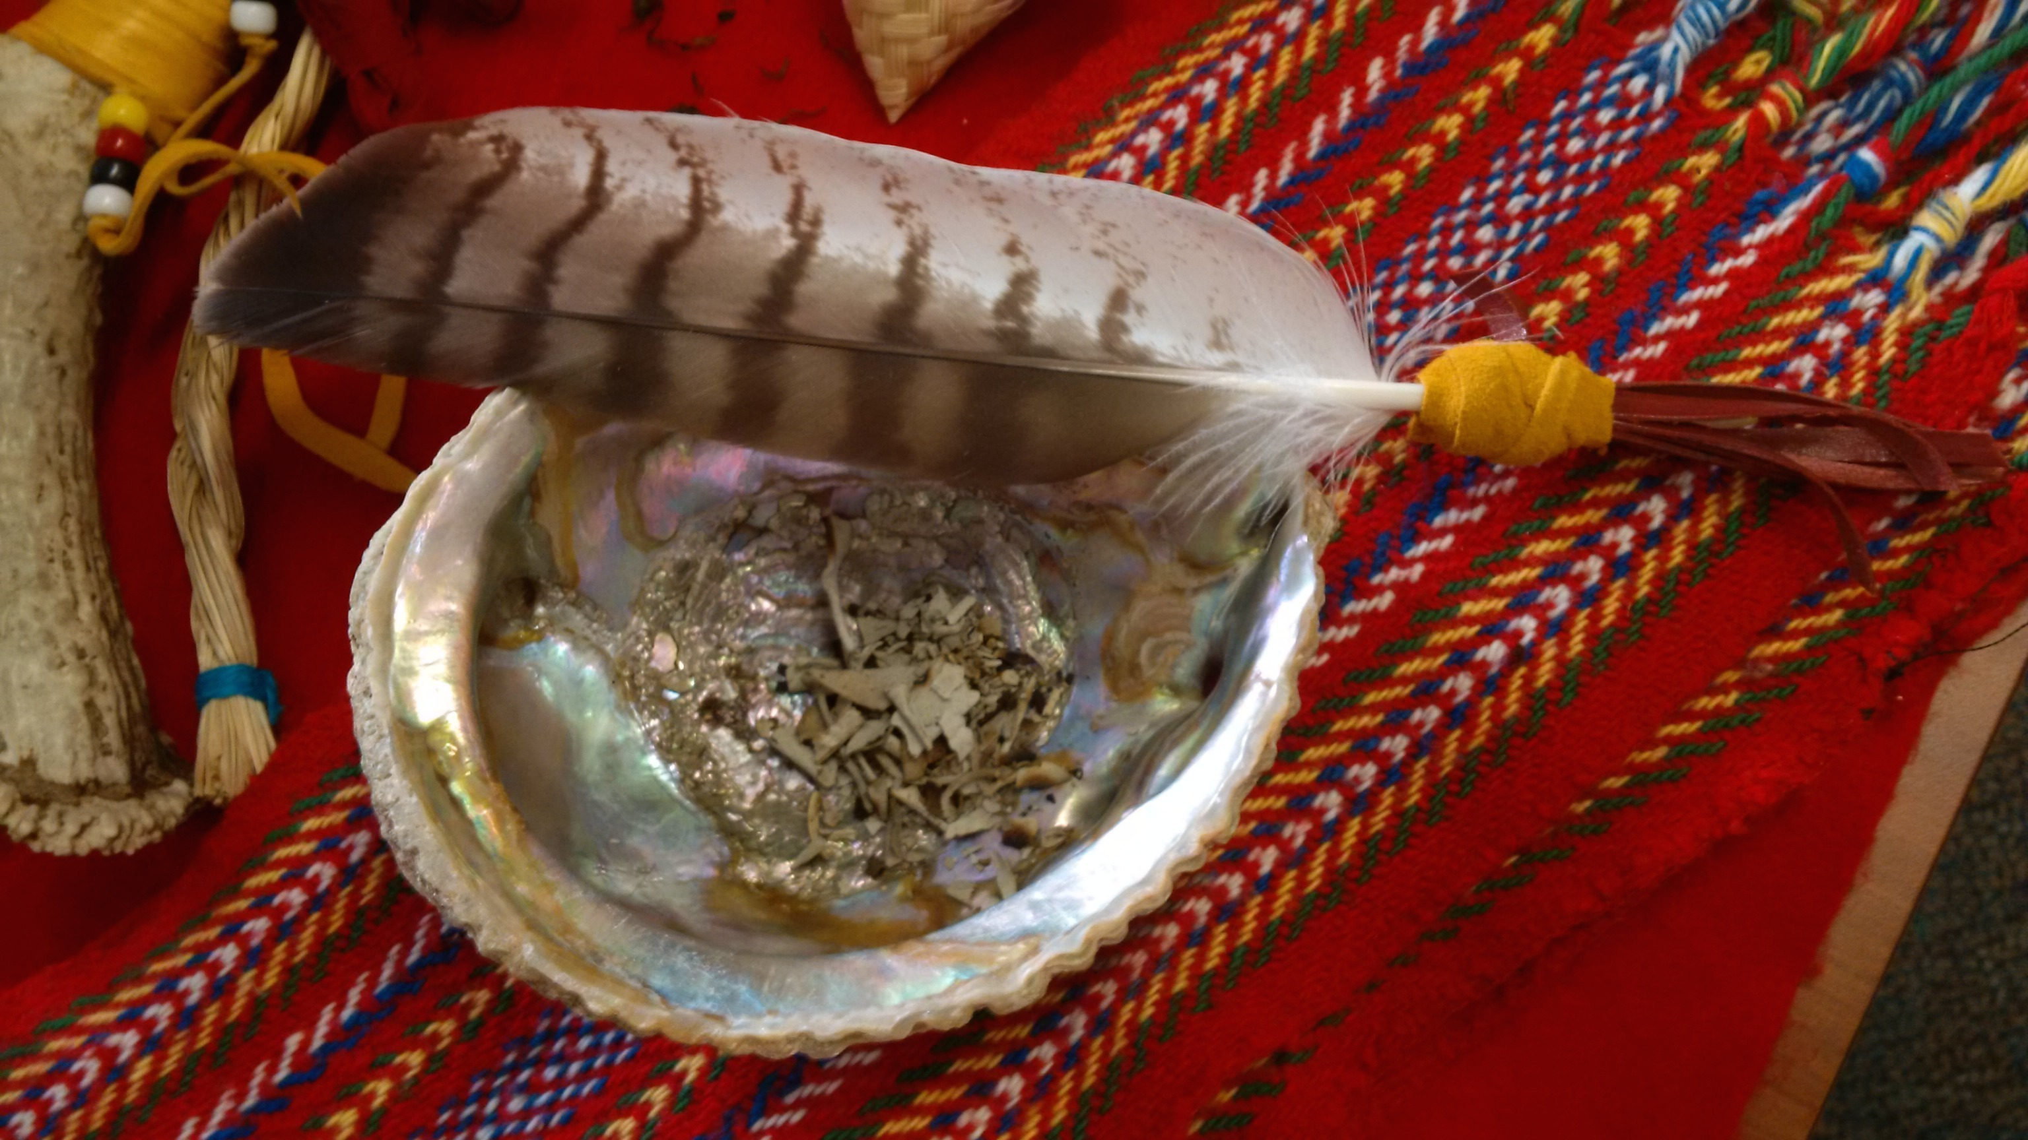
Notes:
Which also entails the offering of respect and an understanding for acts such as smudging, drumming, water ceremonies, harvest ceremonies, full moon ceremonies, etc.

Slide 14
There are more First Peoples living in Cities and Urban areas across Canada today than living on reserves or in territories.

Slide 15
Approximately 7,000 First Peoples currently reside in the Greater Kingston Region/Community Management Area
refs. (1) Social Planning Council of Kingston and Area. (2009). Kingston Community Profile 2009, A Socio-Demographic Analysis of Kingston, Ontario, Canada.
(2) Ontario Trillium Foundation. (2008). Aboriginal Communities in Profile: Quinte, Kingston, Rideau. Toronto, Ontario.
Notes:
There is an increasing visibility within the local Indigenous community to be proud sharing traditions and teachings.

Slide 16
Continue to Make Yourself Aware…
Notes:
Finally, the First Peoples Community of Kingston asks for all people to continue in making yourself aware…

Slide 17
Local First Peoples Statements of Hope…
...You don’t have to be Aboriginal to be part of the process.
...We need to be living [the] respect and sensitivity [that we wish to see in each other]...
...Let’s empower people to promote healing and powerful change in their own lives...
...[There needs to be] Education of allies to challenge the systemic gaps...
...[First People] Community members are looking for change, [in the form of being] given the fishing rod and not just the fish any longer...
Notes:
…for as one local Grandmother offered during our assets and needs assessment conversation that “when the questions stop coming, we assume no one cares.”

Slide 18
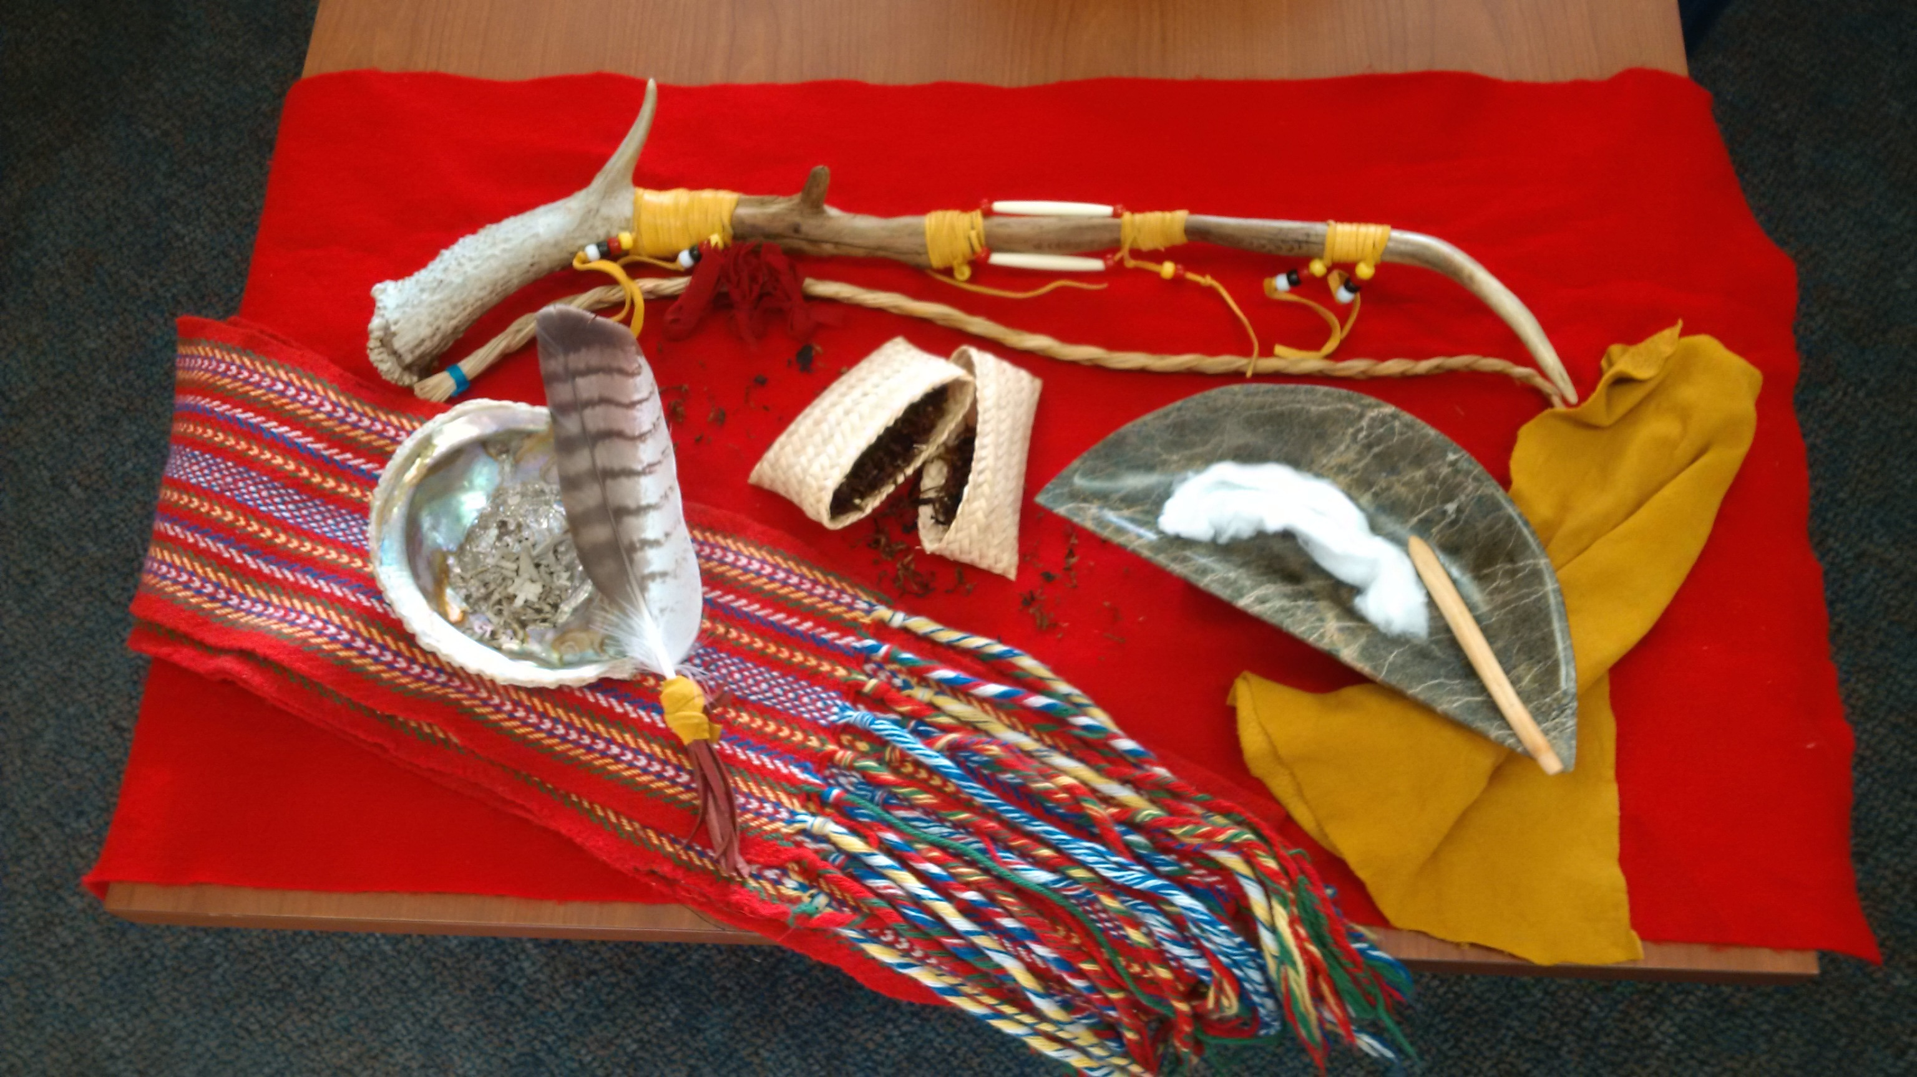
Chi Miigwetch, Nya:wen’ko:wa, Marsee Beaucoup, Thank you very much
Akina Nindinawe, Akwe Nia’Tetewa:neren,
All My Relations

